Slide 1
Extreme Programming(XP)
An agile framework for efficient development.
Name: Shusmita Ghosh Shoili
ID: IT-21006
Session: 2020-21

Slide 2
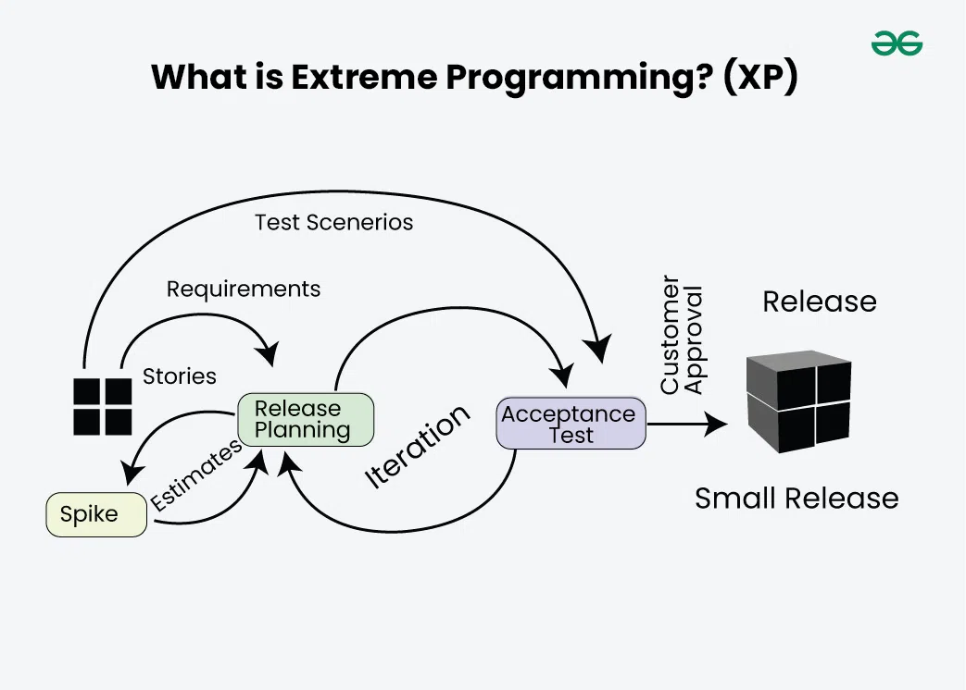
Introduction to Extreme Programming
Extreme Programming (XP) is a software development methodology that falls under the Agile umbrella. It was introduced by Kent Beck in the late 1990s as a response to challenges faced in traditional software development methods. XP emphasizes flexibility, communication, and customer satisfaction, making it ideal for projects with frequently changing requirements. The focus of XP lies in improving software quality and responsiveness through frequent releases and close collaboration between developers and stakeholders.

Slide 3
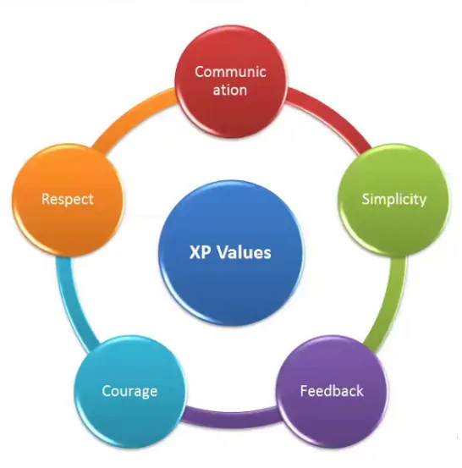
Core Principles of XP
Extreme Programming operates on five core principles that guide its practices:
Communication: Encourages constant dialogue among team members and stakeholders to avoid misunderstandings.
Simplicity: Strives to create the simplest solution that works, reducing unnecessary complexities.
Feedback: Relies on regular feedback loops from testing and customer reviews to stay aligned with expectations.
Respect: Cultivates a culture of mutual respect among team members, valuing each person’s contributions.
Courage: Promotes bold decision-making, including the courage to refactor code or discard ineffective practices. These principles form the foundation of XP’s success in delivering high-quality, adaptive software.

Slide 4
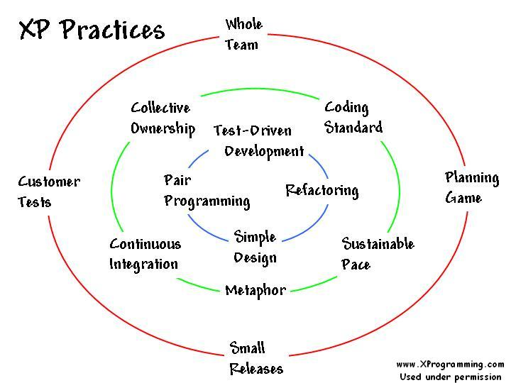
Practices in Extreme Programming
XP practices are designed to foster collaboration, reduce errors, and ensure the delivery of functional software:
Test-Driven Development (TDD): Tests are written before code, ensuring functionality is built into the software from the start.
Pair Programming: Two developers work together on the same task to enhance code quality and share knowledge.
Continuous Integration: Code changes are integrated frequently to catch and resolve conflicts early.
Refactoring: Regular improvements to code maintain its simplicity and efficiency without altering functionality.
User Stories: Short, simple descriptions of desired features written from the user's perspective, aiding prioritization. Together, these practices encourage adaptive, error-resistant, and customer-focused development

Slide 5
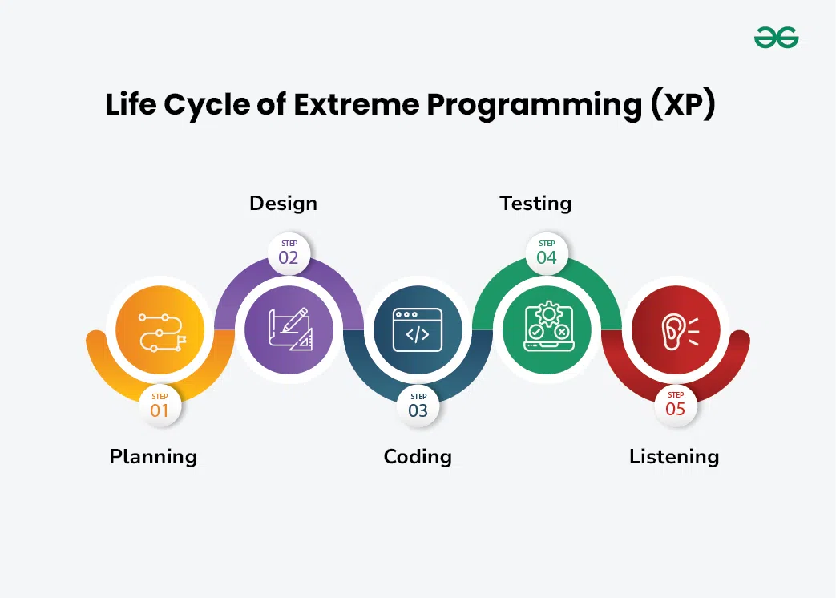
XP Workflow
The XP workflow revolves around iterative development, ensuring adaptability and continuous improvement.
It begins with Planning, where user stories and priorities are defined.
This is followed by Coding, where developers implement features with simplicity and collaboration.
Next is Testing, a critical phase to identify bugs and validate functionality through TDD and continuous testing practices.
Finally, Listening plays a vital role as feedback from customers and team members refines the process and aligns it with project goals. The cycle repeats, incorporating lessons learned to optimize outcomes.

Slide 6
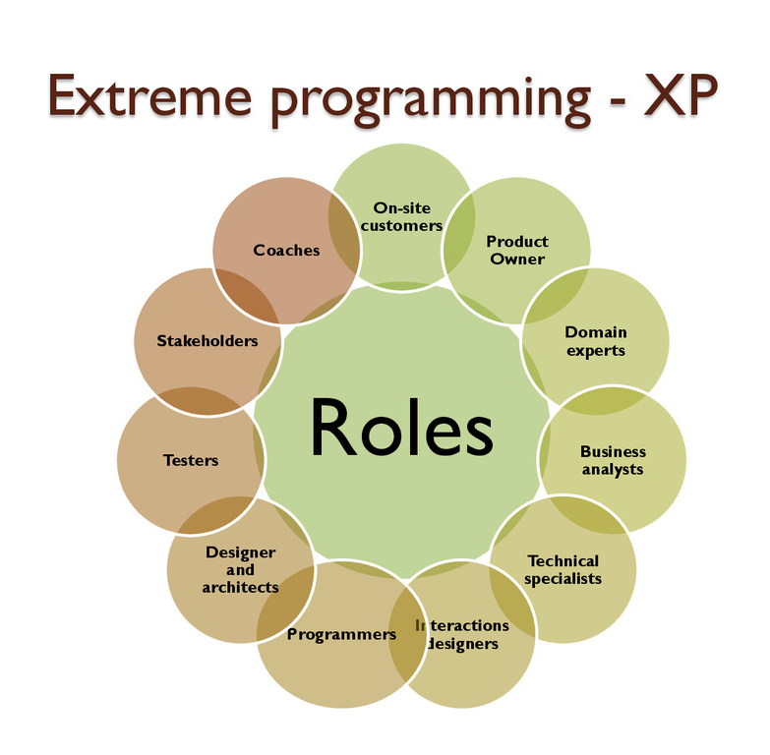
XP Roles
XP defines specific roles to ensure smooth operation and accountability:
Customers: Act as the voice of the user, providing requirements, priorities, and feedback.
Developers: Implement user stories, write tests, and refactor code to meet project goals.
Tracker: Monitors project progress, identifies bottlenecks, and ensures timelines are met.
Coach: Provides guidance on XP principles and practices, ensuring adherence to the methodology. These roles foster collaboration and accountability, ensuring that every aspect of the project is well-managed.

Slide 7
Benefits of XP
XP offers several advantages that make it a preferred choice for modern software projects:
Enhanced Collaboration: Regular communication among team members and customers reduces miscommunication.
High Adaptability: Frequent iterations allow teams to adjust to changing requirements without disrupting the process.
Improved Code Quality: Practices like TDD and pair programming lead to robust, error-free code.
Faster Delivery: Continuous integration and incremental development ensure timely delivery of functional software. These benefits make XP an ideal framework for projects requiring agility and precision.

Slide 8
Challenges in Implementing XP
Despite its strengths, XP faces some challenges in implementation:
Skill Dependency: Requires highly skilled developers to effectively use practices like TDD and pair programming.
Resistance to Pair Programming: Not all developers are comfortable sharing their workspace and thought process.
Scalability Issues: XP is better suited for smaller teams and may not scale efficiently for large organizations.
Customer Involvement: Heavy reliance on customer feedback can be difficult if the customer is unavailable or unclear about requirements. Addressing these challenges requires thoughtful planning and commitment to XP’s principles.

Slide 9

Real-world Applications
XP has been successfully implemented in various industries where rapid and adaptive development is crucial. Startups often adopt XP due to its focus on frequent releases and customer collaboration. Larger organizations have used it for projects with dynamic requirements.
Case studies highlight its success in industries like fintech, where speed and accuracy are paramount. The framework has also been instrumental in open-source projects, where diverse contributors benefit from its collaborative approach.

Slide 10
Conclusion
Extreme Programming stands out as a flexible and effective Agile methodology. By focusing on collaboration, simplicity, and continuous feedback, XP ensures high-quality software development that aligns with user needs. While it requires skilled practitioners and dedicated customer involvement, its benefits far outweigh the challenges. XP is an excellent choice for teams seeking to deliver innovative solutions in dynamic environments.

